Slide 1


Slide 2
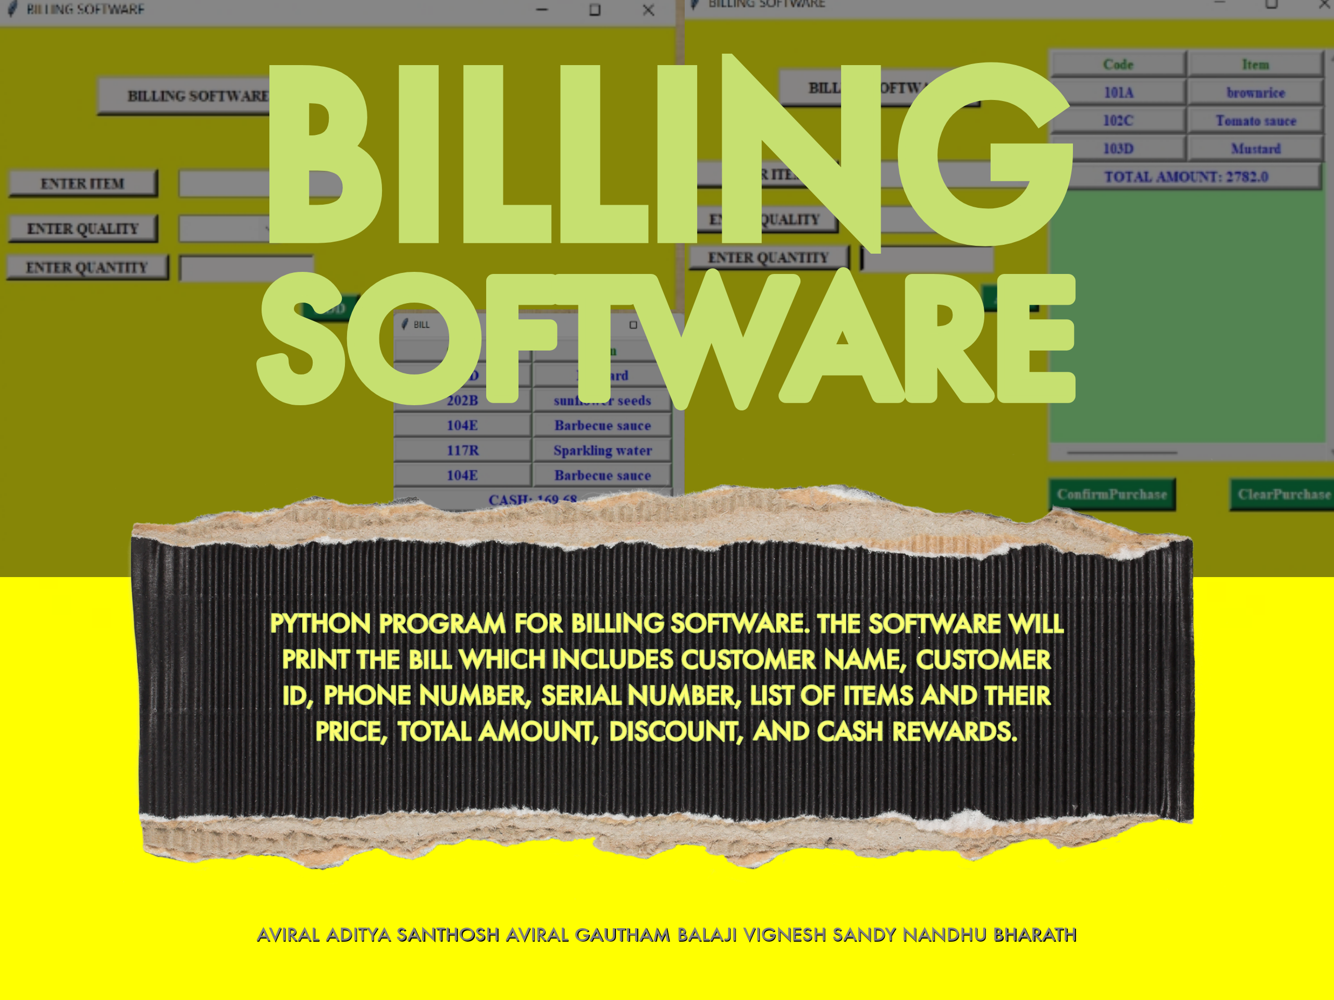

Slide 3

BILLING SOFTWARE
We have written a Python program for a billing software.
The software will identify the items and its price using its product code and quality levels.
Then, the software will calculate the price of the total quantity of each item, discounts or cash rewards and total bill amount.
The software will also include rewards in the total bill based on the purchase amount.
The software will then finally print the bill which include Customer name, customer ID, phone number, Serial number, list of items and their price, total amount, discount and cash rewards.

Slide 4
TEAM MEMBERS
21BCE1825 | Aviral Singh
21BCE1826 | Illur Jyothi Reddy
21BCE1827 | Gautham Vidyashankar
21BCE1828 | Barathwaj K K
21BCE1829 | Santhosh Kumar
21BCE1830 | Santhosh C V
21BCE1831 | Mathuku Balaji Reddy
21BCE1832 | Aviral Bansal
21BCE1833 | Adithya V
21BCE1834 | Macha Naga Sai Vignesh

Slide 5
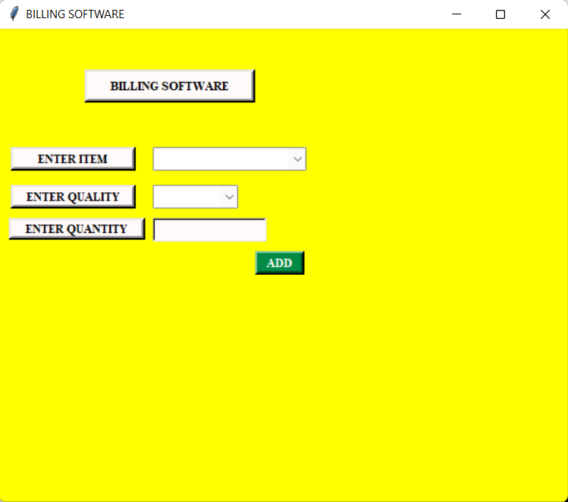
This is the basic layout of the program.
We can see three tabs with different functions.
Enter item gives a drop down menu containing all the items available in the store.
Enter quality gives another drop down menu which lists all the prices for that item.
We write the number of items we need in the quantity tab.

Slide 6

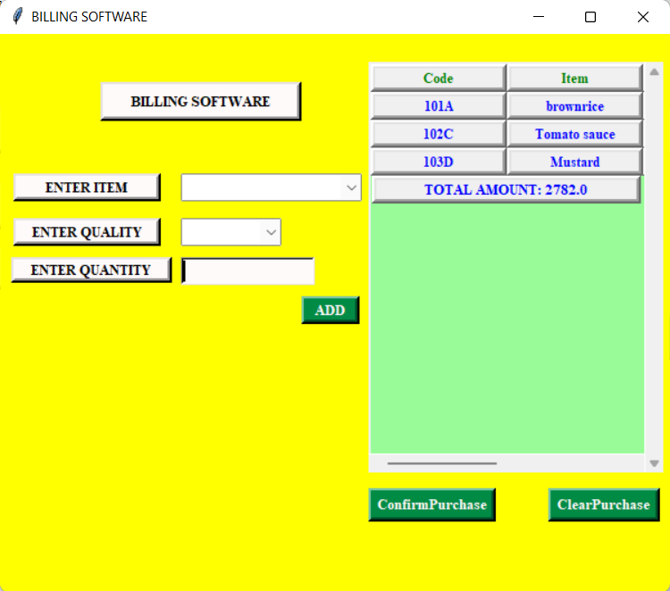
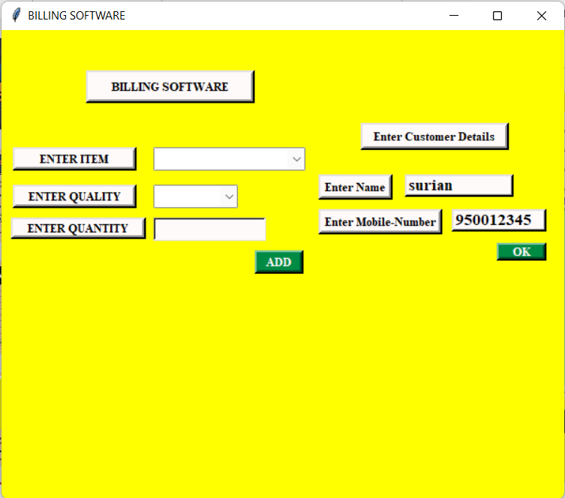
Every time when the user add items its added in the cart provided in the side and also the total amount will be updated along with it.
Confirm and Clear purchase options were also given for the user’s Choice.
When the Confirm Purchase Button is pressed, it ask for the Customer Details( Name, Mobile Number)
After pressing the ok button, the bill will be created accordingly in a separate window

Slide 7
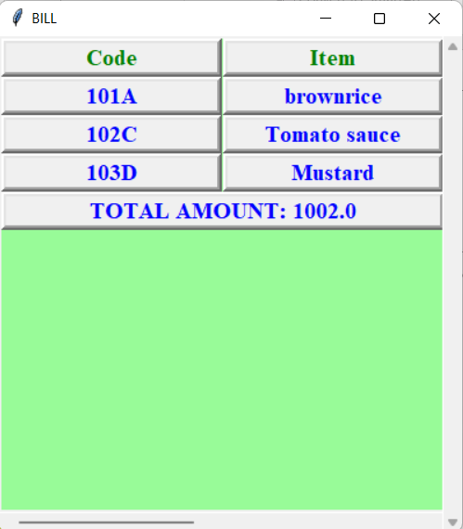
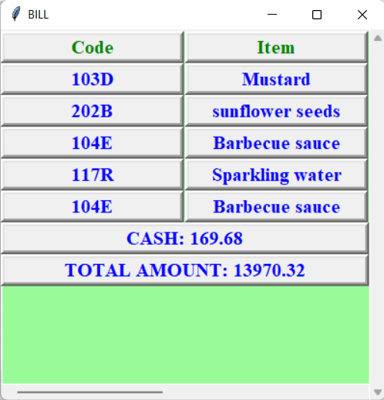
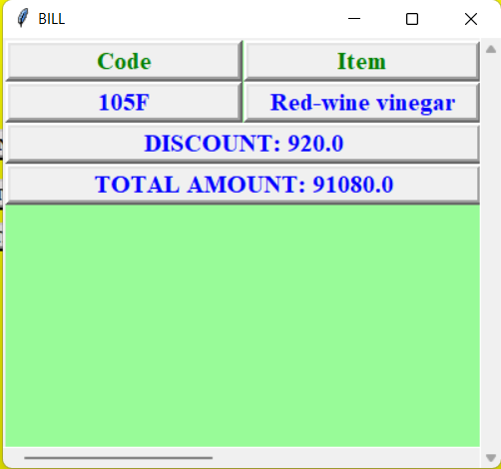
When the total amount is more than 10000 and it’s a new customer
When the total amount is more than 10000 and the customer Is already registered
When total amount is just around than 10000

Slide 8
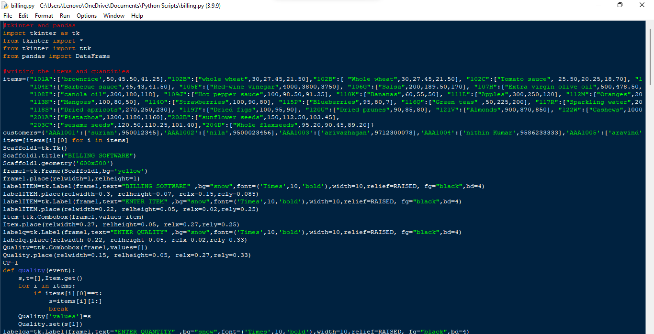
We have used tkinter to make the program.

